Slide 1

Aerospike Advanced Concepts
Counters

Slide 2
Objective
After successful completion of this module you should be able to:
Use the Operate API
Understand atomic counters
Code a solution in
C#
Java

Slide 3
Atomic
“An atomic transaction is an indivisible and irreducible series of database operations such that either all occur, or nothing occurs”
https://en.wikipedia.org/wiki/Atomicity_(database_systems)
Aerospike atomic operations are single Record only.

Slide 4
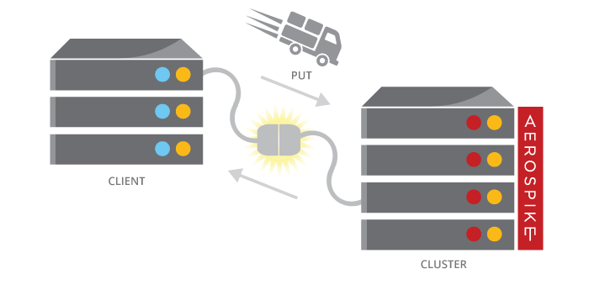
Operate
Multiple operations atomically on the same Record
Update and Select in one operation
Read and Write operations
Write first
Read last
Example: add to a counter and read the value

Slide 5
Counters
Use Operate API with:
Add operation
Get operation
New value in the returned Record
// Java
// Add integer to the cat counter, and read the record.
Key key = new Key(ns, set, "a-record-with-one-counter");
Bin cat = new Bin(catCountBin, 1); // Increment by 1
Record record = client.operate(null, key,
Operation.add(cat),
Operation.get());
// C#
// Add integer to the cat counter, and read the record. Key key = new Key(ns, set, "a-record-with-one-counter"); Bin cat = new Bin(CatCountBin, 1); // Increment by 1 Record record = client.Operate(null, key,
Operation.Add(cat),
Operation.Get());

Slide 6

Example use case: Frequency capping
Frequency capping is restricting (capping) the number of times (frequency) a person is shown an Ad.
Implemented with a counter, per cookie/device id, per Ad

Slide 7
Exercises: Counters

Slide 8
Exercises and Answers
Directory layout
csharp
answers
exercises
Java
answers
exercises
Java: Maven project
C#: Visual studio (and Xamarin) solution

Slide 9
Java: Counters
Find the Program.java file in the exercises directory. Edit the file to:
Implement a “cat” counter and increment it by 1
Increment the “cat counter by 3 and the “dog” counter by 2
Decrement the ”cat” counter by 1
// Add integer to the cat counter, and read the record.
Key key = new Key(ns, set, "a-record-with-one-counter");
Bin cat = new Bin(catCountBin, 1); // Increment by 1
Record record = client.operate(null, key,
Operation.add(cat),
Operation.get());
// Add integer to the cat counter and dog counter, and read the record.
key = new Key(ns, set, "a-record-with-two-counters");
cat = new Bin(catCountBin, 3); // Increment by 3
Bin dog = new Bin(dogCountBin, 2); // Increment by 2
record = client.operate(null, key,
Operation.add(cat),
Operation.add(dog),
Operation.get());
// Subtract integer from the cat counter , and read the record.
cat = new Bin(catCountBin, -1); // Decrement by 1
record = client.operate(null, key,
Operation.add(cat),
Operation.get());
Notes:
Aerospike can perform multiple operations on a record in one transaction. Update the tweet count and timestamp in a user record and read the new tweet count.
In TweetService.updateUser()
Comment out the code added in exercise 2
Uncomment the line:
In TweetService.updateUserUsingOperate() , add code similar to this:

Slide 10
C#: Counters
Find the Program.cs file in the exercises directory. Edit the file to:
Implement a “cat” counter and increment it by 1
Increment the “cat counter by 3 and the “dog” counter by 2
Decrement the ”cat” counter by 1
// Add integer to the cat counter, and read the record. Key key = new Key(ns, set, "a-record-with-one-counter"); Bin cat = new Bin(CatCountBin, 1); // Increment by 1 Record record = client.Operate(null, key,
Operation.Add(cat),
Operation.Get());
// Add integer to the cat counter and dog counter, and read the record. key = new Key(ns, set, "a-record-with-two-counters"); cat = new Bin(CatCountBin, 3); // Increment by 3 Bin dog = new Bin(DogCountBin, 2); // Increment by 2 record = client.Operate(null, key,
Operation.Add(cat),
Operation.Get());
// Subtract integer from the cat counter , and read the record. cat = new Bin(CatCountBin, -1); // Decrement by 1 record = client.Operate(null, key,
Operation.Add(cat),
Operation.Get());

Slide 11


